Slide 1
Module 6

Slide 2
Architecture for Cloud Application:
6.1 Cloud Application requirements- Architecture for traditional Vs Cloud Applications Multi-ties Application Architecture SOA for Cloud applications – Resource oriented SOA – Method –oriented SOA and Event Driven SOA – Parallelization within Cloud Applications – Leveraging In memory Operations for Cloud Application.

Slide 3
Application architecture is the design of a software application that outlines internal subcomponents and interaction between modules and interface with external applications or services.
It is a design or plan that defines what the application will contain and how it will interact with infrastructure components.
The application itself is designed to automate specific business tasks in a coherent and logical manner to help users conveniently interact with others to store and share data.
In traditional application architecture, one or more Web servers interact with the database using a middle-tier software or application framework. This architecture is designed to meet stable demand levels of the consumers. It is not scalable and not meant for huge variations in user or system load.

Slide 4
The process of migrating applications to the cloud needs to be carefully planned. In the near future, the majority of applications migrated to the cloud will be having similar architectures as those deployed on-premises today, and users should not expect qualitatively different experiences from cloud deployments, unless they develop the code to suit the cloud.
Many organizations are in the process of porting and migrating existing internal applications to public or private clouds.
If properly transitioned, it has the potential to add outstanding value and solve many issues for users.
It can also enable organizations to streamline their business operations in many ways. However, applications that were not fundamentally architected and written for use in the cloud will work similar to traditional on-premise applications installed on a cloud.
Currently, due to lack of skills in the cloud-based application architecture, the ability to add and use additional features in the cloud seems to be limited.
Moreover, the costs and time required for rebuilding the existing applications are prohibitive. The 10 features described in this chapter are fundamental factors of cloud applications.

Slide 5
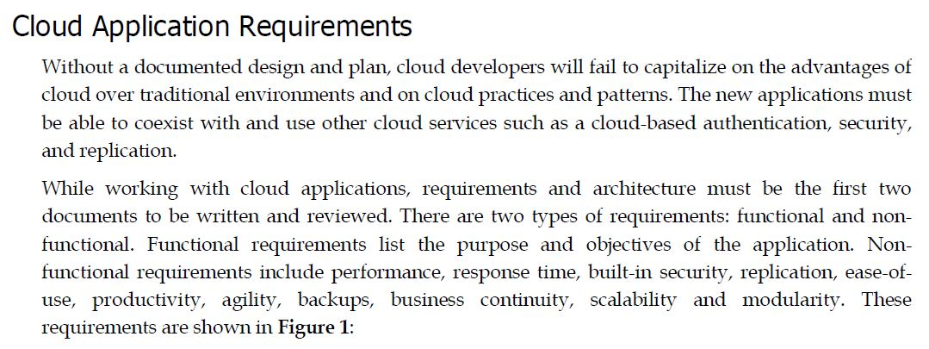

Slide 6
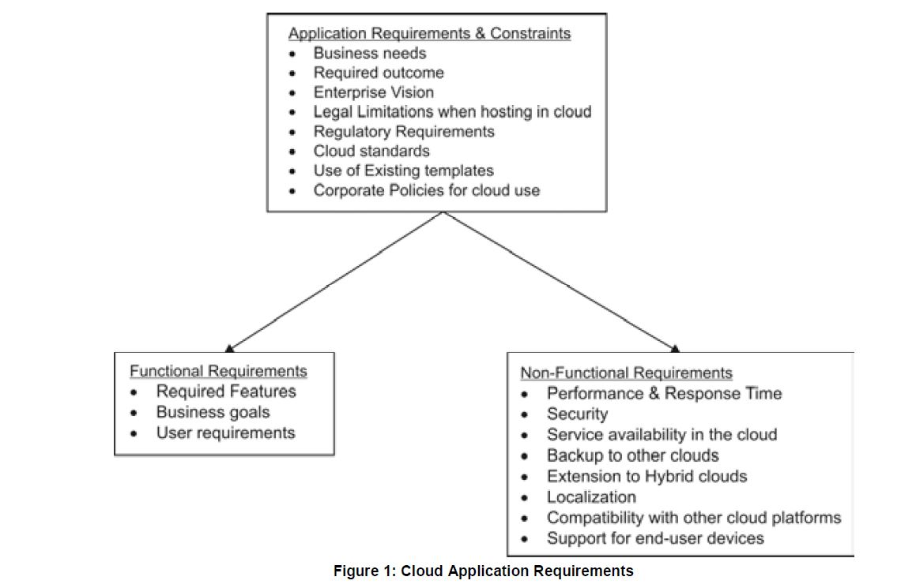

Slide 7
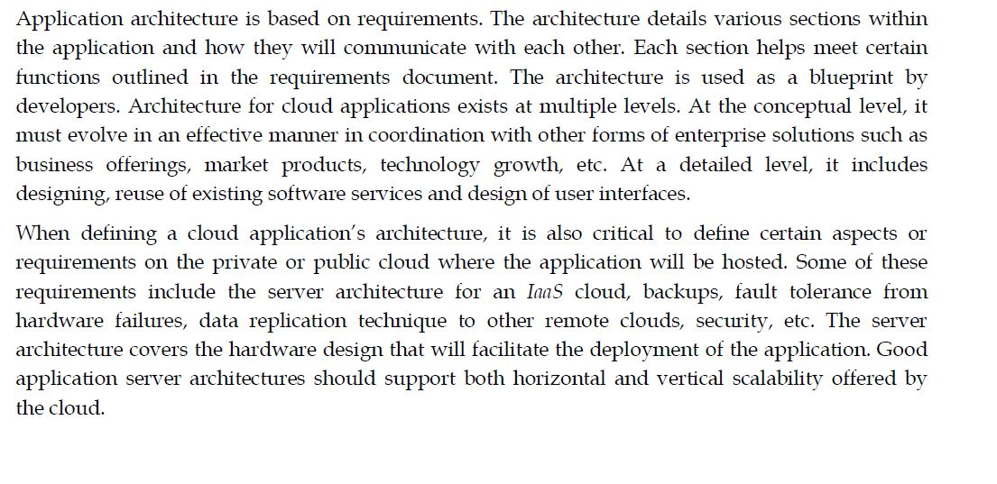

Slide 8
Traditional vs. Cloud Applications:
Traditional Applications:
Deployment: Traditional applications are typically deployed on physical servers
or in on-premises data centers.
Scalability: Scaling traditional applications often involves adding more physical hardware,
which can be time-consuming and costly.
Maintenance: Maintenance and updates may require manual intervention
and can lead to downtime.
Resource Management: Resources are statically allocated, and there is limited flexibility
for resource optimization.
Cloud Applications:
Deployment: Cloud applications are hosted on cloud infrastructure, often using
virtual machines, containers, or serverless computing services.
Scalability: Cloud applications can easily scale up or down based on demand,
allowing for auto-scaling and cost optimization.
Maintenance: Cloud providers handle much of the underlying infrastructure maintenance,
reducing operational overhead.
Resource Management: Cloud applications benefit from dynamic resource allocation,
optimizing resource utilization.

Slide 9
Multi-Tier Application Architecture:
Traditional Multi-Tier Architecture:
Presentation Layer: This is the user interface where interactions with the application occur.
Application Layer: This layer contains the business logic and application functionality.
Data Layer: Data storage and retrieval components are housed in this layer, often using relational databases.
Cloud Multi-Tier Architecture:
Presentation Layer: Remains similar, but may include front-end web applications hosted in the cloud.
Application Layer: Often includes microservices, serverless functions, or containerized applications that can be easily managed and scaled in the cloud.
Data Layer: Cloud-native databases, data warehouses, or object storage solutions are used, offering scalability and managed services.

Slide 10
Service-Oriented Architecture (SOA) for Cloud Applications:
SOA in Traditional Applications:
In traditional applications, implementing SOA may involve complex middleware and ESB (Enterprise Service Bus) solutions.
Service components are often tightly coupled and may not be easily reusable or interchangeable.
Scaling and managing services can be challenging.
SOA in Cloud Applications:
Cloud-native SOA leverages cloud services and serverless computing to build loosely-coupled, independently deployable services.
RESTful APIs, gRPC, or event-driven communication patterns are used for service interaction.
Services can be independently scaled and managed in response to varying workloads.
Serverless functions, containers, or Kubernetes can be used to deploy and manage services in a cloud-native SOA.

Slide 11
In summary, cloud applications offer more flexibility, scalability, and reduced operational burden compared to traditional applications. Cloud-native architectures, including multi-tier and SOA, are designed to take full advantage of cloud infrastructure and services, enabling businesses to adapt to changing demands and accelerate innovation.

Slide 12
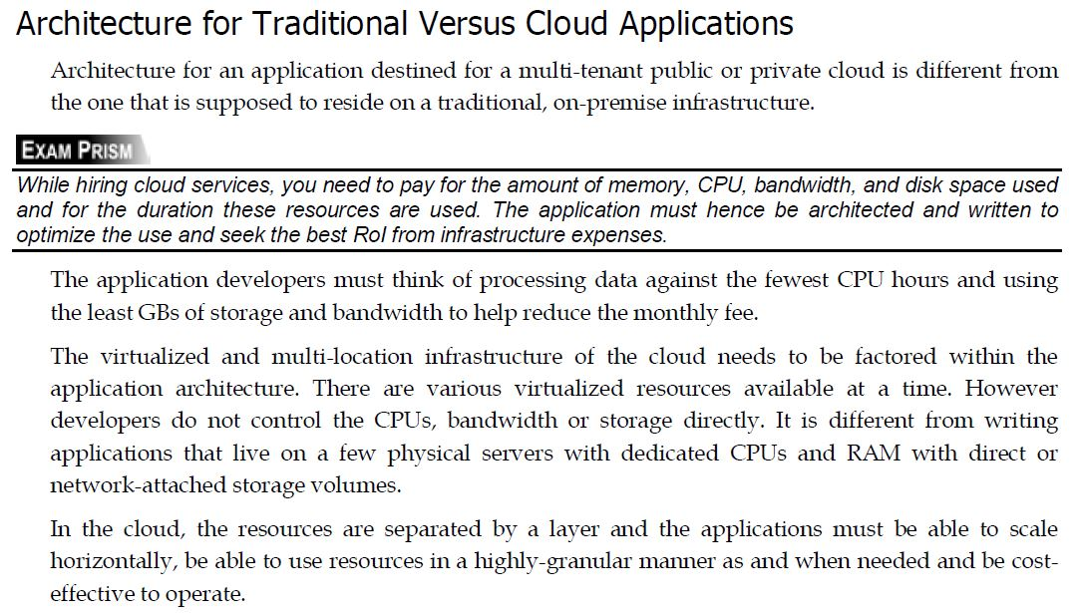

Slide 13
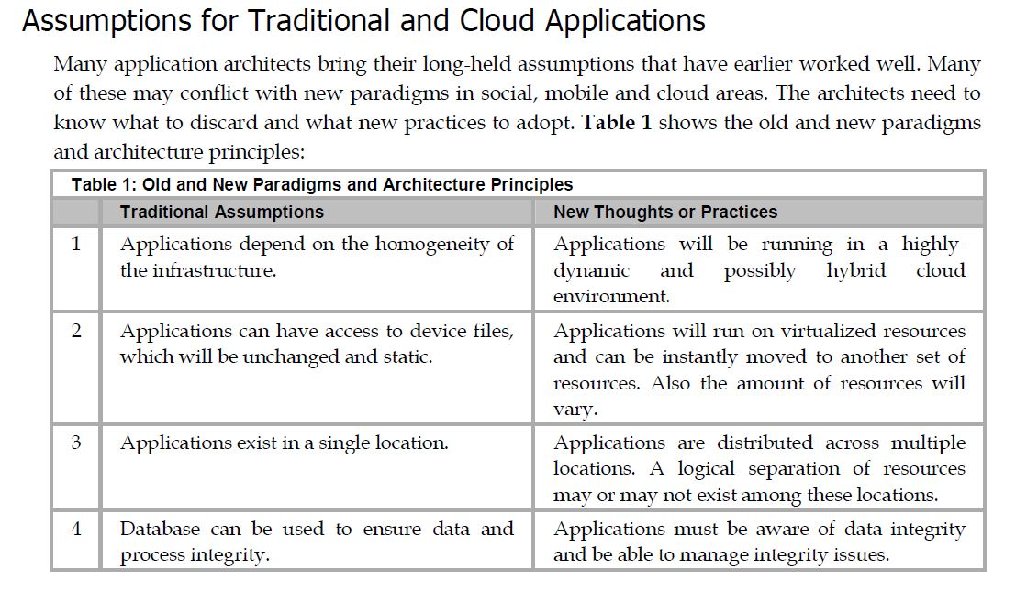
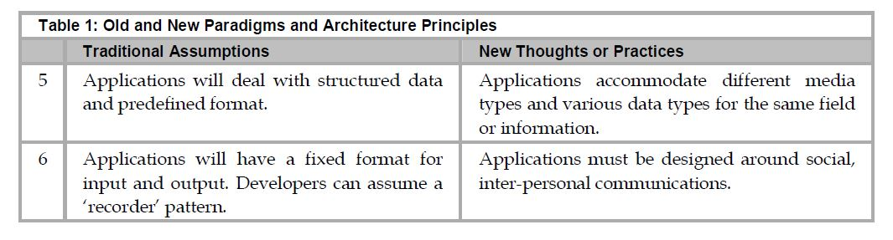

Slide 14
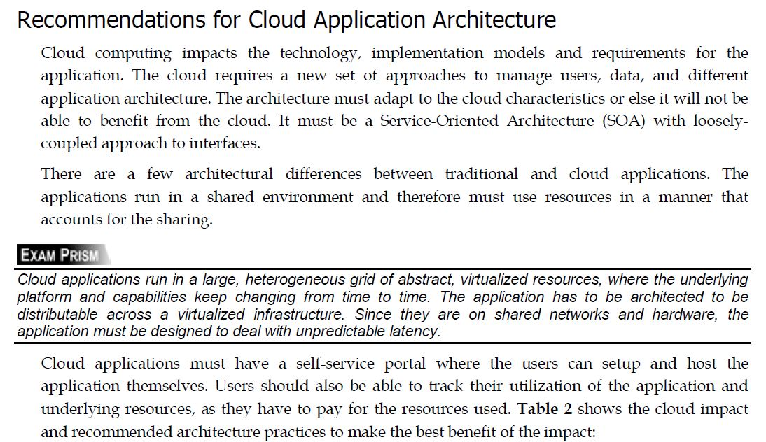

Slide 15
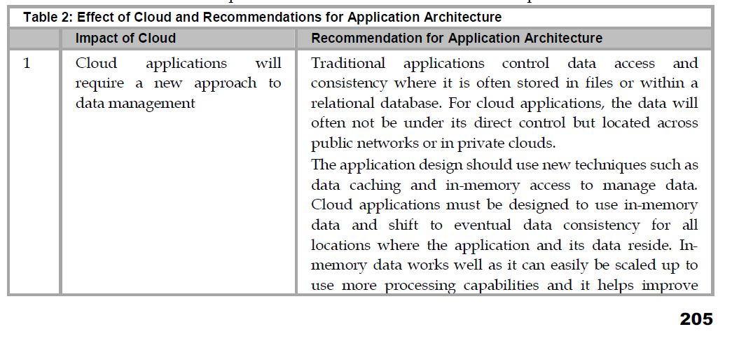

Slide 16
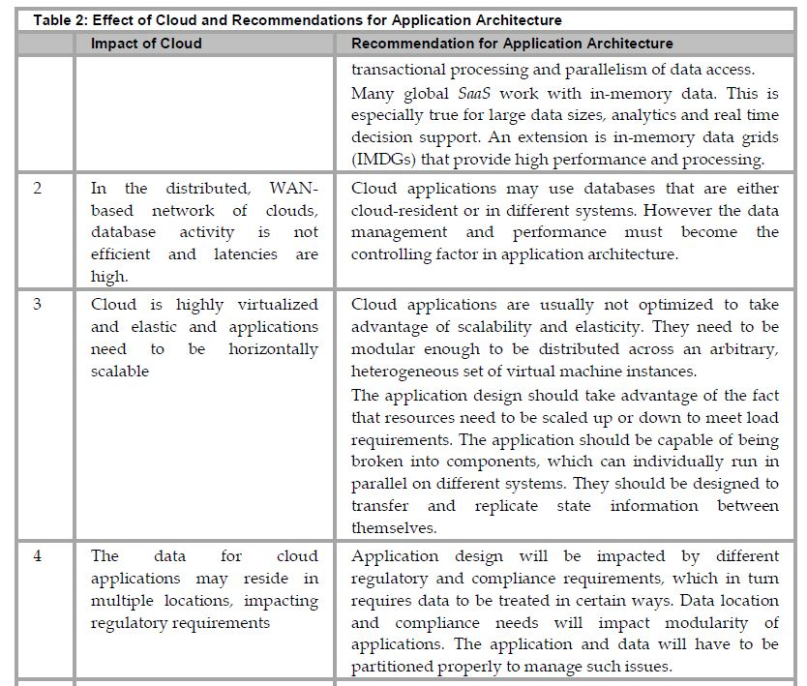

Slide 17
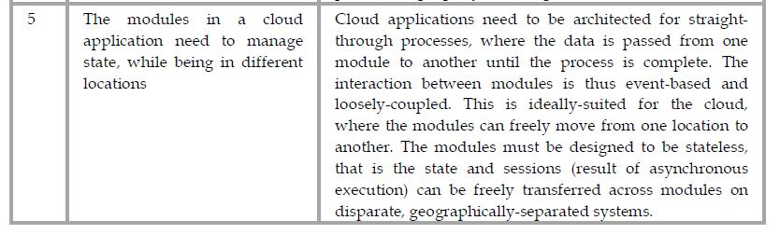
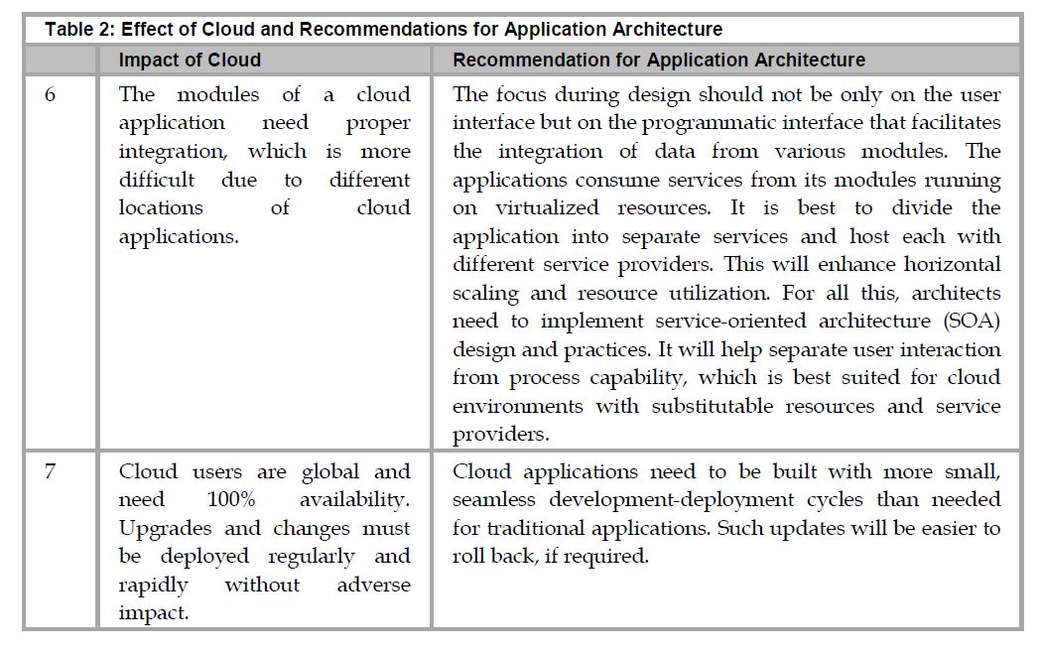

Slide 18
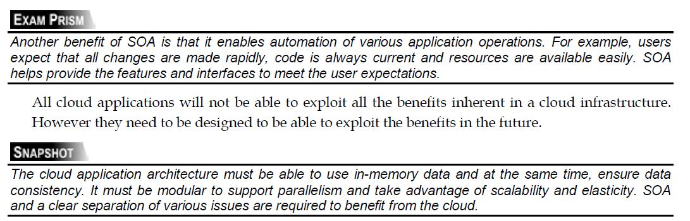

Slide 19
Fundamental Requirements for Cloud Application Architecture
Cloud Applications Must be Flexible, Dynamic, and Distributable
Cloud Applications Must be Architected and Installed for Unknown and Varying Geographic Locations
Cloud Applications Must Account for Pricing of Resource Access and Utilization—
Cloud Applications Must Take Care of Data Integrity and Consistency
Cloud Applications Must Process Various Information Types—
Cloud Applications Must be More Mobile-Aware
Applications Must Do Lot More Than Just Accepting and Storing Input

Slide 20
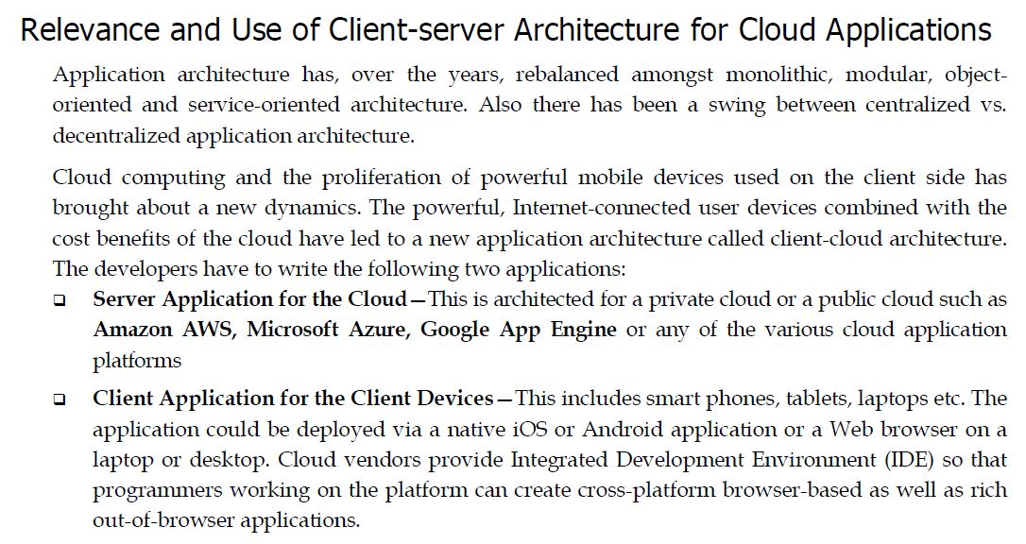

Slide 21
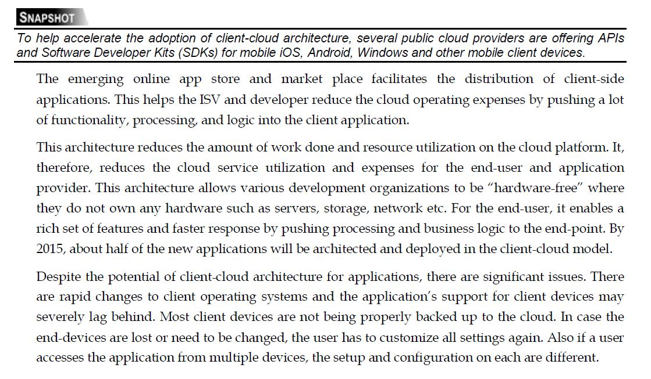

Slide 22
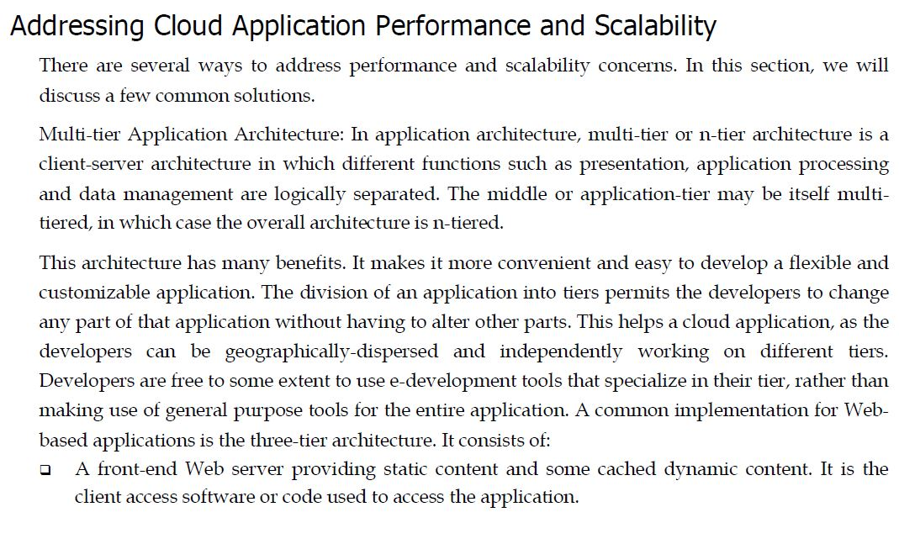

Slide 23
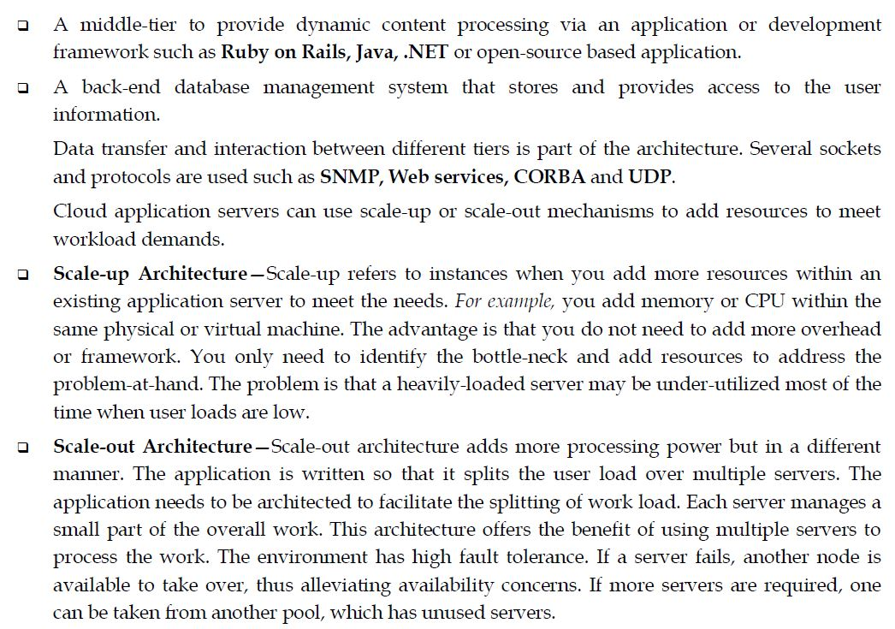

Slide 24
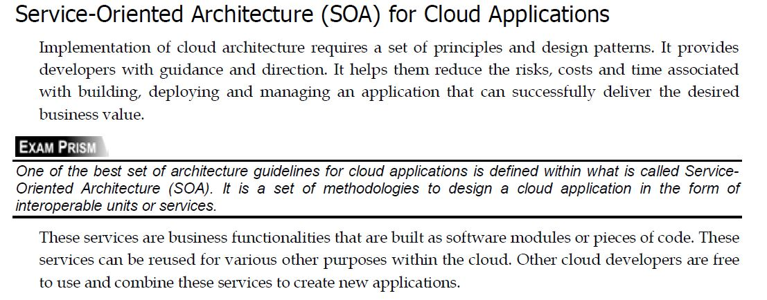

Slide 25
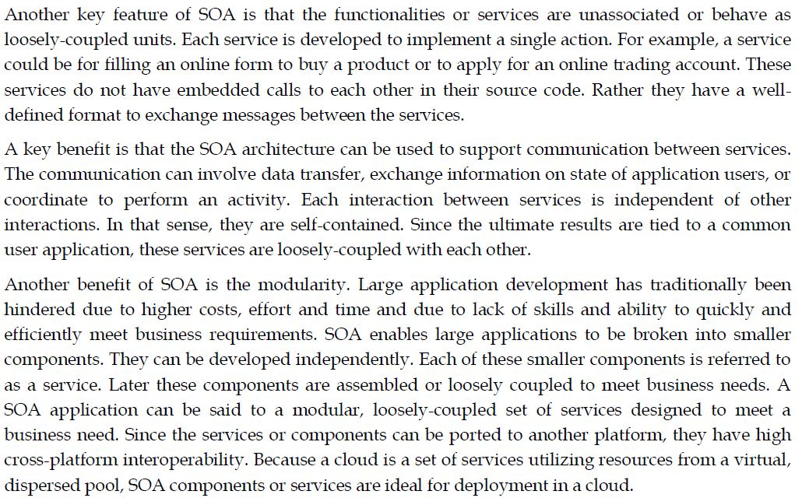

Slide 26
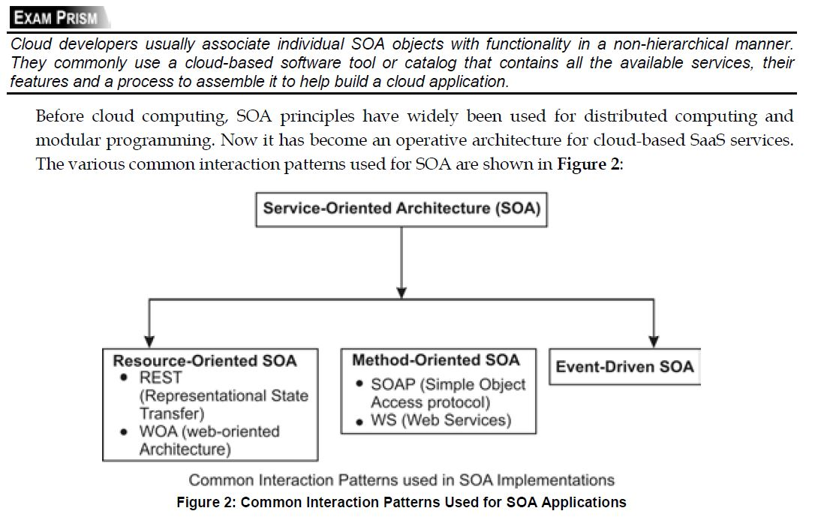

Slide 27
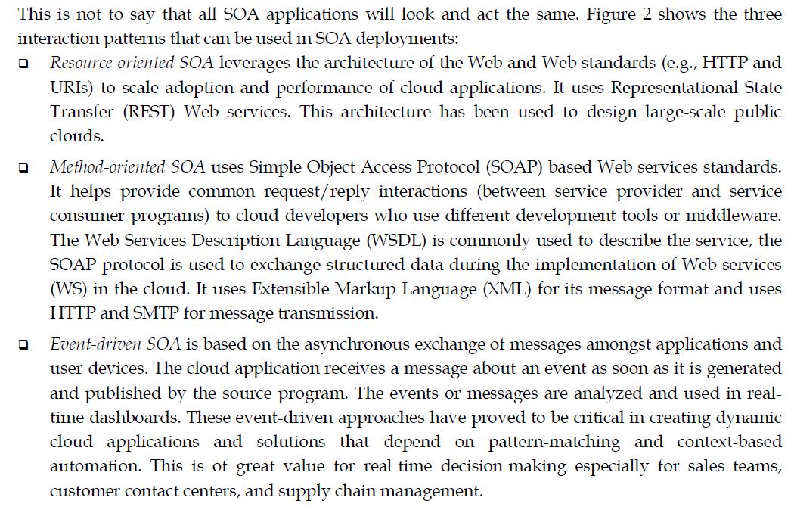

Slide 28
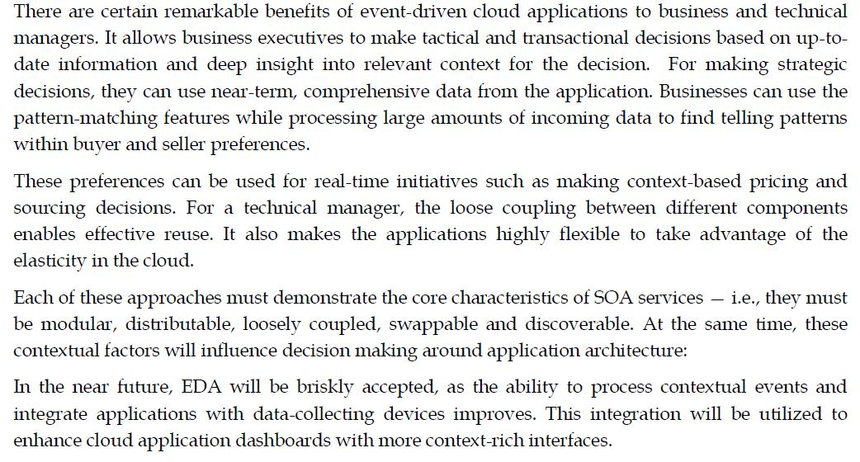

Slide 29
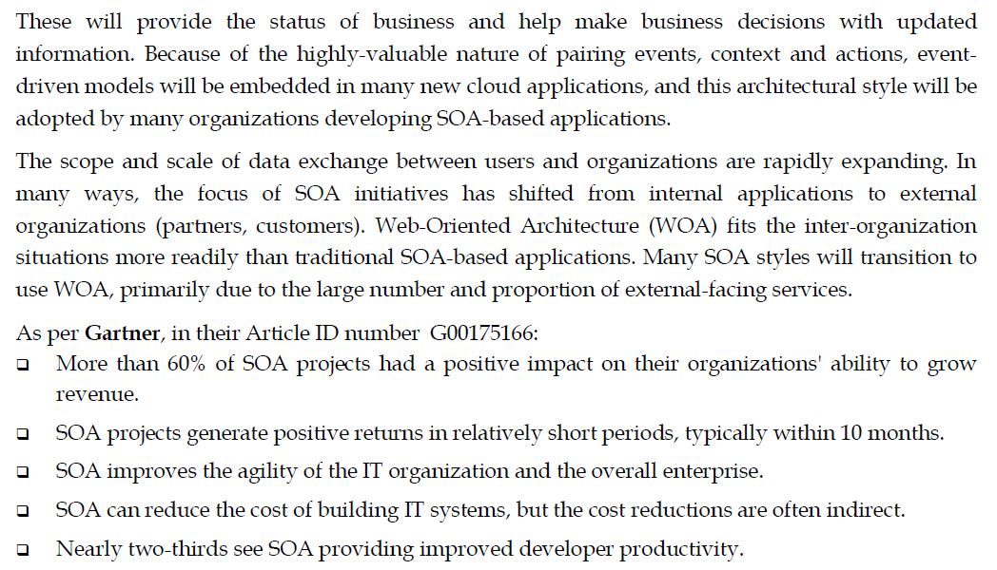

Slide 30
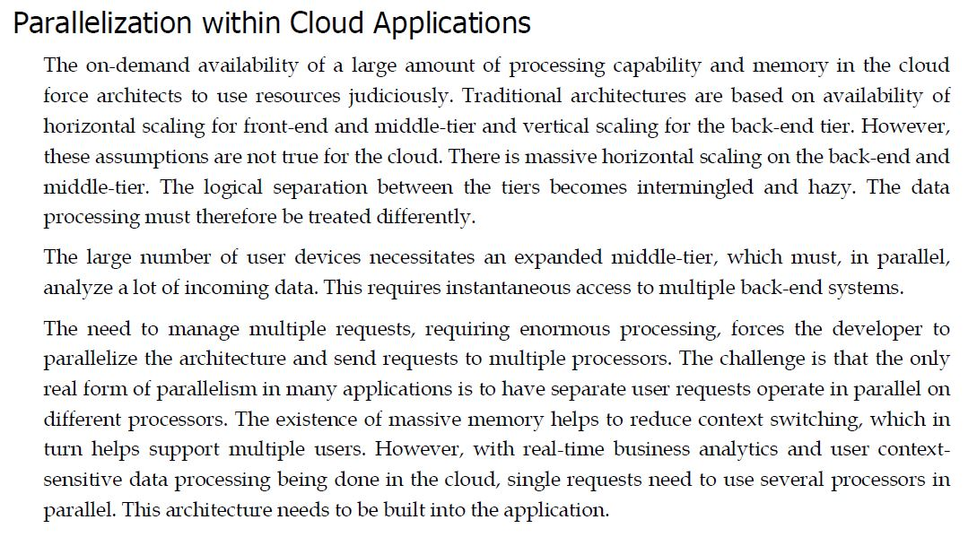

Slide 31
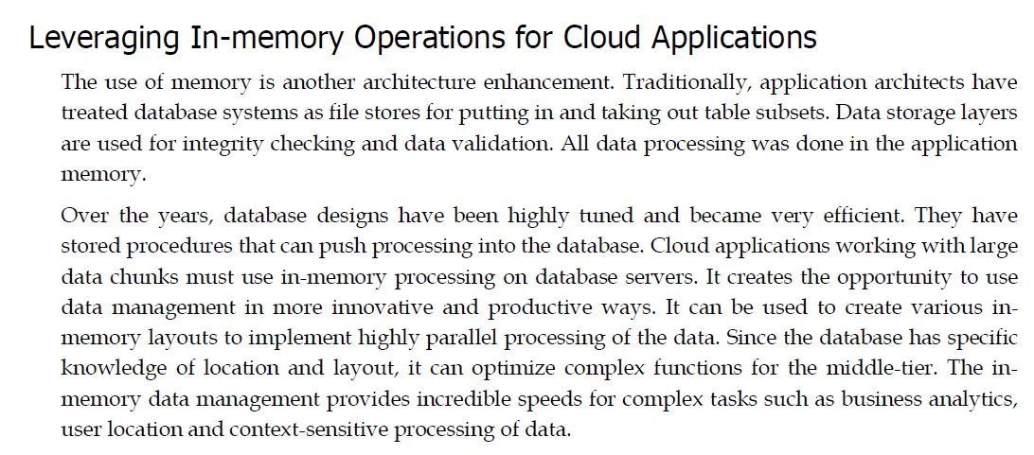

Slide 32
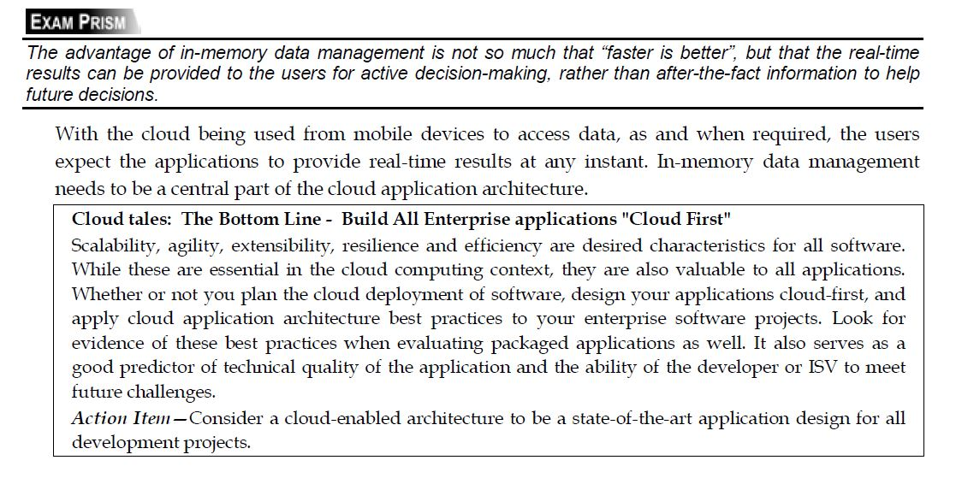

Slide 33
Points to Remember
Application architecture is the design of a software application, including all internal subcomponents and outline of the interfaces with all external applications or services.
Applications will need to be re-architected to take advantage of cloud features such as elasticity and on-demand availability and to address risks in a multi-tenant cloud.
The cost and time required to re-architect on-premise applications is prohibitive.

Slide 34
On one hand, some infrastructure-related advantages such as cloud backups and pay-per-use model will benefit almost all cloud applications.
Benefits such as elasticity, optimized resource utilization and parallelism cannot be realized without re-architecting the applications specifically for cloud use.
Furthermore, the lack of skills in cloud application architecture will prove to be a serious deterrent for porting traditional applications to the cloud.
Whether or not you plan cloud deployment for your applications, you must design your applications to be cloud-ready from the start and apply best practices for cloud application architecture.

Slide 35
The following are the basic requirements for cloud application architecture:
Cloud applications must be flexible, dynamic and distributable.
Cloud applications must be architected and installed for unknown and varying geographic locations.
Cloud applications must account for Pricing of Resource Access and utilization.
Cloud applications must take care of data integrity and consistency.
Cloud applications must process various information types.
Cloud applications must be more mobile-aware.
Applications must do a lot more than just accepting and storing input.

Slide 36
One of the best set of architecture guidelines for cloud applications is defined within what is called service-oriented architecture (SOA), which is a set of methodologies to design a cloud application in the form of interoperable units or services.
Other useful features of SOA are its modularity and that the functionalities or services are unassociated. They behave as loosely-coupled units, where each unit is designed to implement a single action.
Cloud application architecture specifies guidelines and suggestions to developers and helps them use event-driven, time-driven or SOA models.
There are three main interaction patterns used in SOA architecture:
Resource-oriented SOA that leverages the architecture of the Web and Web standards such as HTTP and URIs. It uses representational state transfer (REST) Web services.
Method-oriented SOA that uses Simple Object Access Protocol (SOAP)-based Web services standards and provides common request/reply interactions (between service provider and service consumer programs) to cloud developers.
Event-driven SOA, which is based on the asynchronous exchange of messages amongst applications and user devices.
Event-driven models and SOA are being increasingly introduced into cloud applications.
SOA uses Web-oriented architecture (WOA) extensively to work with other Web services in the
same or other clouds.

